Slide 1
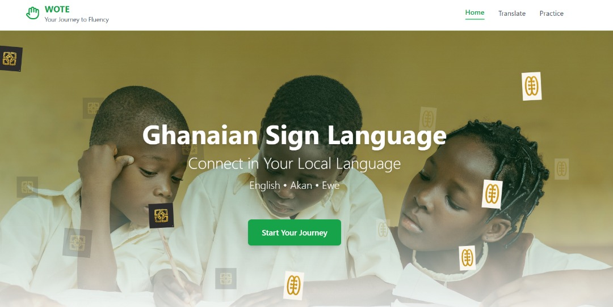


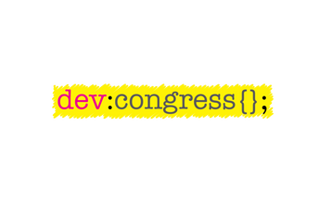


AI for Inclusive
Learning
HACKATHON
Day 2 Bounty
PROBLEM
Ghana lacks culturally grounded tools that support GSL and offer Deaf and hearing learners a shared, accessible space to communicate and learn together.
Many believe “sign language is too hard,” which creates a social and psychological barrier that is much bigger than the linguistic one.
In collaboration with
Notes:
Inclusive learning tells us let’s build tools that understand our languages, our ways of speaking, our rhythms, our cultural cues.

Slide 2
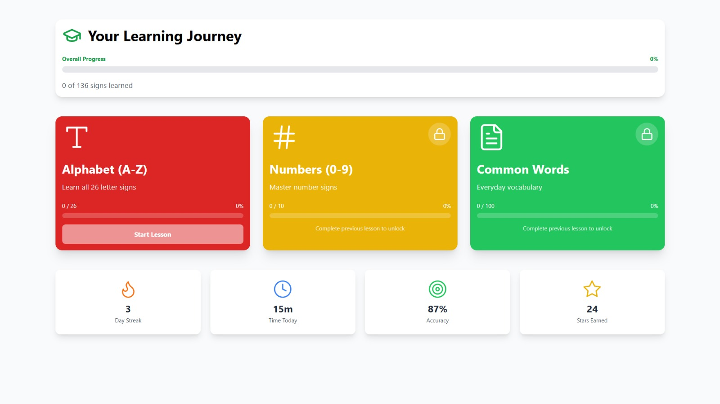
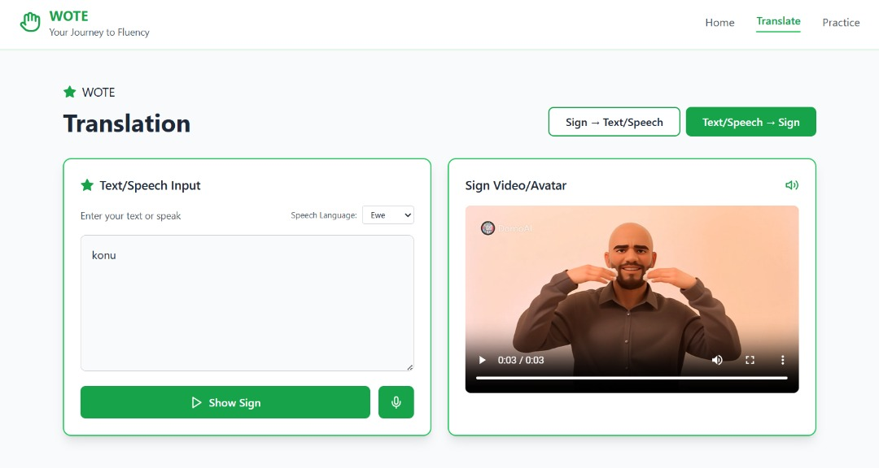
AI for Inclusive
Learning
HACKATHON
Day 2 Bounty
SOLUTION
An AI-powered platform that translates between Ghanaian Sign Language and Ghana’s major spoken languages (English, Twi, Ga, Ewe)
WOTE provides real-time GSL → speech/text and speech/text → GSL translation in Ghanaian languages.
Teaching and supporting GSL in ways that match Ghana’s cultural rhythms.
Multiplayer learning mode on Telegram so students, teachers, and families can learn and practice GSL together — anytime, anywhere, even with low internet.
In collaboration with

Slide 3
AI for Inclusive
Learning
HACKATHON
Day 2 Bounty
USER USE CASE/TARGET AUDIENCE
Persona 1 — Efua (Deaf Student, Age 12)
Efua sits in class each day with ideas she can’t fully share, but with WOTE’s real-time GSL translation and multiplayer practice, she finally joins discussions and her classmates learn to sign with her, not around her.
Persona 2 — Ama (Teacher Who Doesn’t Know GSL)
Ama is a dedicated teacher who struggles to communicate with her Deaf students, and WOTE becomes her classroom companion — translating questions, helping her teach, and giving her a simple, structured way to learn GSL alongside her pupils.
Persona 3 — Kojo (Hearing Classmate, Age 14)
Kojo wants to include his Deaf friend but doesn’t know where to start, and WOTE’s fun multiplayer lessons on Telegram give him a way to learn, play, and communicate confidently in GSL.
Persona 4 — Yaa & Kofi (Parents of a Deaf Child)
At home, conversations are often confusing for Yaa and Kofi, but WOTE helps them understand their child’s signs, practice together at home, and communicate with love instead of frustration.
In collaboration with
Notes:
To make learning really inclusive Efua we have to make the people around include the people around her.

Slide 4
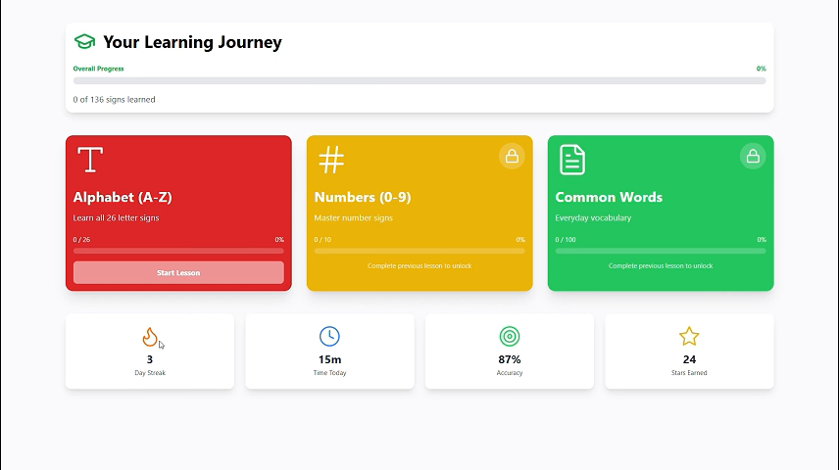
AI for Inclusive
Learning
HACKATHON
Day 2 Bounty
LEARNING DEMO
In collaboration with

Slide 5
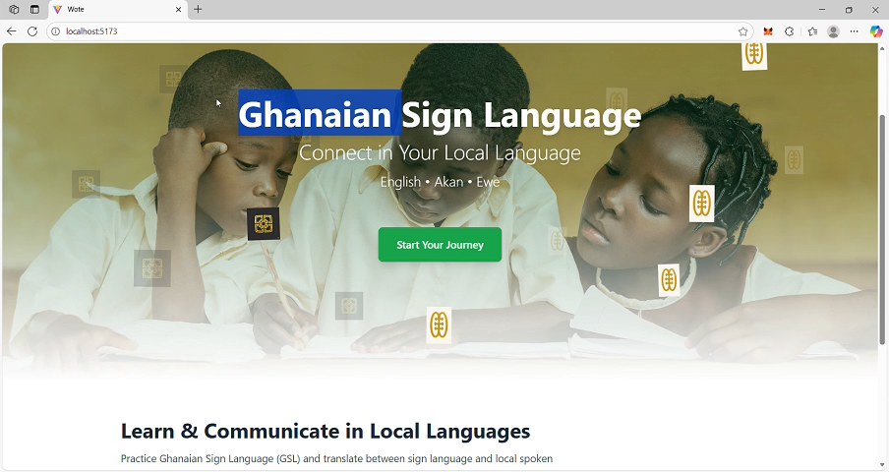
AI for Inclusive
Learning
HACKATHON
Day 2 Bounty
BIDIRECTIONAL CONVERSATION DEMO
In collaboration with

Slide 6
AI for Inclusive
Learning
HACKATHON
Day 2 Bounty
IMPACT
Reduced isolation
More Deaf students participating in class
More inclusive workplaces
Strengthened cultural identity through local-language AI
A national step forward in Ghana’s digital inclusion agenda
Teachers able to communicate without needing full GSL fluency
Increased public awareness and learning of GSL
In collaboration with

Slide 7
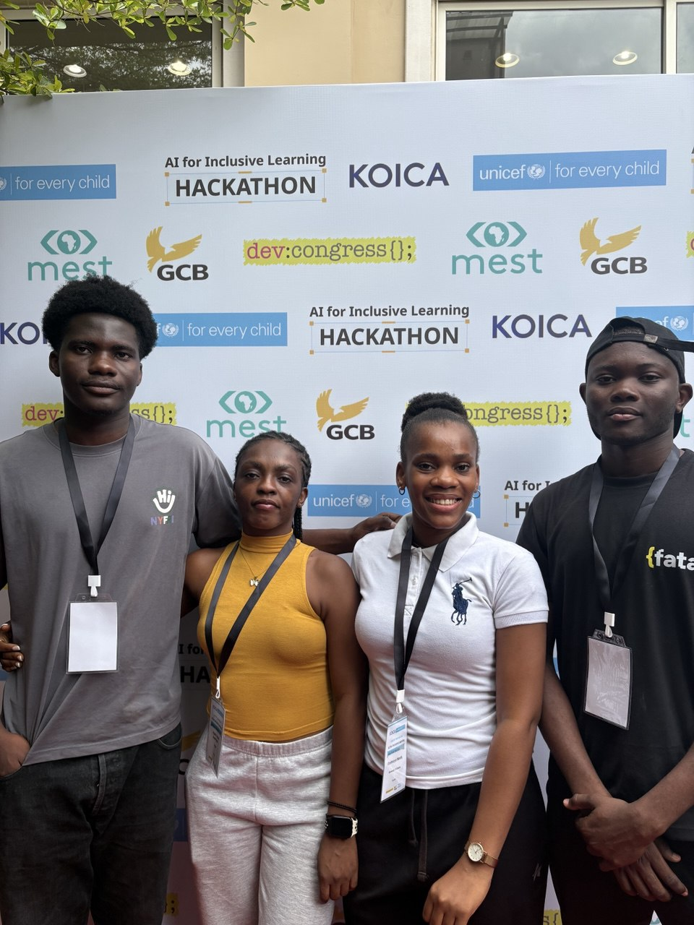
AI for Inclusive
Learning
HACKATHON
Day 2 Bounty
TEAM TWILIGHT
DANIEL NTIRI ADDO
SEMANYOH NISSI KEKELI
WENDY ENYINNAYA
AGNES ASAMOAH
https://github.com/lordofcodess/sign_language
In collaboration with

